Slide 1
“PREDICTION OF CHRONIC KIDNEY DISEASE USING MACHINE LEARNING ”
Department of CSE
Major Project
Guide Name
Mrs. S Suguna
Asst. Prof CSE
MVJCE
Team Members
Archana S Malakhed (1MJ18CS022)
Deepthi HP (1MJ18CS035)
Dharani K (1MJ18CS037)
G. Lakshmi Keerthi (1MJ18CS048)

Slide 2
CONTENTS
Abstract
Proposed System
System Architecture
Class Diagram
Use-case Diagram
Module 1
Module 2
Module 3
Module 4
Module 5
Requirements
Conclusion

Slide 3
ABSTRACT
One of the biggest health problems in the world is chronic kidney disease (CKD), which can lead to renal failure, cardiovascular disease (CVD), and early death. For patients who progress to end-stage kidney disease, insufficient availability to kidney replacement therapy is a problem in many regions of the world. According to research, 1 in 10 people may have CKD, however it is more prevalent in adults than children, where it affects 1 in 50 people and 1 in 2 persons over the age of 75. Millions of people worldwide die each year from CKD, which affects 10% of the population and typically has no symptoms due to aberrant test findings. Data classification can be used to identify CKD, but the system might not be able to accurately estimate the proportion of CKD patients.
The innovative aspect of this study is the method used to diagnose chronic renal disease. The goal of this project is to compare the accuracy-based performance of different machine learning algorithms employing Liner Classifier, K-Nearest Neighbor (KNN), Support Vector Machine (SVM), Naive Bayes, Random Forest, and XGBoost.

Slide 4
PROPOSED SYSTEM
This proposed system objects to predict Chronic Kidney Disease based on full features and important features of CKD dataset. For feature selection Feature selection technique has been applied. In this perception, six classifiers algorithm were applied viz. Linear Classifier, K-Nearest Neighbor (KNN), Support Vector Machine (SVM), Naïve Bayes, Random Forest, and XGBoost. For each classifier, the results were computed based on full features. Result is concluded by considering accuracy, precision, recall and F1-score. Using Liner Classifier, K-Nearest Neighbor (KNN), Support Vector Machine (SVM), Naive Bayes, Random Forest, and XGBoost machine learning algorithms, we are proposing this CKD system for classification.

Slide 5

SYSTEM ARCHITECTURE
Feature selection
Data Set
Linear Classification
KNN
SVM
Naive Bayes
Random Forest
XGBoost
Classification
Evaluation performance of CKD
CKD
NON-CKD

Slide 6
Class Diagram
Training subset
age bp rbc . . . hemo class
Algorithms
Linear Classifier(95.8%)
KNN(92.5%)
SVM(95%)
Random Forest(98%)
XGBoost(98%)
Navie Bayes(96%)
Comparison
Data Set
Datapreprocessing KNN imputer
Testing subset
age bp rbc . . . hemo class
More Accurate Algorithm
Datapreprocessing KNN imputer

Slide 7
Use case Diagram
Gather known data
Prepare data set
preprocessing
Choose algorithm
Examine and update
Comparison
Actor
use model with new data for prediction

Slide 8
MODULE 1: DATA PREPROCESSING
Data Preprocessing is a process of preparing the raw data & making it suitable for ML models. It is the first & crucial step while creating a ML model
It includes the following steps
Getting the dataset
Importing libraries
Finding missing data
Splitting the data set into training & testing
NOTE: Data set chosen from Chronic KIdney Disease dataset | Kaggle

Slide 9
DATA PREPROCESSING
In this dataset, a total of 25 attributes are used, 24 features, and 1 class. Of 24 attributes some attributes are nominal and some attributes are numerical attributes. In this dataset, nominal values contain sg, rbc, al, su, pc, pcc, ba, dm, cad, appet, pe, ane these attributes convert to numeric values. Now our dataset is completely in numeric form. And splitting the dataset into 75%-25% for testing and training use.
The 75%-25% test train split is one of the most common and best splits. This is why 75-25 was used.
Since missing values are only present in the features data and not in the target class, missing value imputation can be used.
KNN Imputation method is used to impute missing/na values because the sample size is relatively small and discarding records would not be a good option as the sample size will further decrease. Furthermore, KNN imputation works best for numerical values

Slide 10
MODULE 2: FEATURE SELECTION
The goal of feature selection in a machine learning is to find the best set of features that allows one to build useful models of studied phenomena.
Benefit of feature selection is that:
It reduces overfitting
Improves the accuracy
Reduces the computation time
Basically feature selection optimize the model by selecting a subset of the feature to use

Slide 11
MODULE 3: IMPLEMENTATION
Algorithms used
Linear Classifier
KNN
SVM
4. Random Forest 5. XGBoost
6. Navie Bayes

Slide 12
1. LINEAR CLASSIFIER
A linear classifier is a model that makes a decision to categories a set of data points to a discrete class based on a linear combination of its explanatory variables. As an example, combining details about a dog such as weight, height, color and other features would be used by a model to decide its species
A linear classifier will draw a straight line (e.g., y=mx+c) to divide sets of points into 2 classes.
Formula:
n
Y = β₀ + ∑ β_{i} . X_{i}
i=0

Slide 13
2. K-Nearest Neighbour Algorithm
It is a supervised ML algorithm used to solve both regression and classification problems.it aims to locate all of the closest neighbors around a data point in order to figure out in which class it belongs.
KNN is one of the simplest machine learning algorithms which is easy to implement.
It is a supervised machine learning algorithm that solves both classification and regression problems. This algorithm stores all the available data and classifies new data based on their similarity.
First select the number of neighbors. Then calculate Euclidean distance between the data points. Euclidean distance is the distance between two points. Formula for Euclian distance is given by:
√ (X₂ – X₁)² + (Y₂ – Y₁)²

Slide 14
3. SUPPORT VECTOR MACHINE
Support Vector Machine or SVM is one of the most popular Supervised Learning algorithms, which is used for Classification as well as Regression problems. However, primarily, it is used for classification problems in Machine Learning.
The goal of the SVM algorithm is to create the best line or decision boundary that can segregate n-dimensional space into classes so that we can easily put the new data point in the correct category in the future. This best decision boundary is called a hyperplane.
SVM chooses the extreme points/vectors that help in creating the hyperplane. These extreme cases are called support vectors, and hence algorithm is termed a Support Vector Machine. Consider the below diagram in which there are two different categories that are classified using a decision boundary or hyperplane.
Formula used for non-linear data:
Z = X² + Y²

Slide 15
4. Random Forest
Random Forest is an ensemble technique capable of performing both regression and classification tasks with the use of multiple decision trees and a technique called Bootstrap and Aggregation, commonly known as bagging. The basic idea behind this is to combine multiple decision trees in determining the final output rather than relying on.
industrial decision trees. Random Forest has multiple decision trees as base learning models. We randomly perform row sampling and feature sampling from the dataset forming sample datasets for every model. This part is called Bootstrap.

Slide 16
4. Random Forest
The random forest algorithm works by completing the following steps:
Step 1: The algorithm selects random samples from the dataset provided.
Step 2: The algorithm will create a decision tree for each sample selected. Then it will get a prediction result from each decision tree created.
Step 3: Voting will then be performed for every predicted result. For a classification problem, it will use mode, and for a regression problem, it will use mean.
Step 4: And finally, the algorithm will select the most voted prediction result as the final prediction.

Slide 17
5. XGBoost
XGBoost is an implementation of Gradient Boosted decision trees. XGBoost models majorly dominate in many Kaggle Competitions.
In this algorithm, decision trees are created in sequential form. Weights play an important role in XGBoost. Weights are assigned to all the independent variables which are then fed into the decision tree which predicts results. The weight of variables predicted wrong by the tree is increased and these variables are then fed to the second decision tree. These individual classifiers/predictors then ensemble to give a strong and more precise model. It can work on regression, classification, ranking, and user-defined prediction problems.

Slide 18
5. XGBoost
Similarity Score = (Sum of residuals)^2 / Number of residuals + lambda
Gain = Left tree (similarity score) + Right (similarity score) - Root (similarity score) Gain - gamma
Output value = Sum of residuals / Number of residuals + lambda

Slide 19
6. Navie Bayes
Naive Bayes classifiers are a collection of classification algorithms based on Bayes’ Theorem. It is not a single algorithm but a family of algorithms where all of them share a common principle, i.e., every pair of features being classified is independent of each other.
Bayes’ Theorem finds the probability of an event occurring given the probability of another event that has already occurred. Bayes’ theorem is stated mathematically as the following equation:
P (yi | X1, X2, ..., Xn) = P (X1 | yi)P (X2 | yi)...P (Xn | yi)P (yi)/P (X1, X2, ..., Xn)

Slide 20
6. Navie Bayes
where A and B are events and P (B) ≠ 0.
Basically, we are trying to find probability of event A, given the event B is true. Event B is also termed as evidence.
P (A) is the priori of A (the prior probability, i.e., Probability of event before evidence is seen). The evidence is an attribute value of an unknown instance (here, it is event B).
P (A|B) is a posteriori probability of B, i.e., probability of event after evidence is seen. Now, with regards to our dataset, we can apply Bayes’ theorem in following way:

Slide 21
MODULE 4: Testing
Testing is an important part of project where testing of each module is done. Testing guarantees that proposed system is well organized analyzed to meet require project goal. Testing is last stage of project which guarantees the system is error free and ready to give desired output. The goals of testing are given by:
Give operational quality to system
Search and remove errors.
Best quality project is produced.
To approve the product as a solution for the first issue.

Slide 22
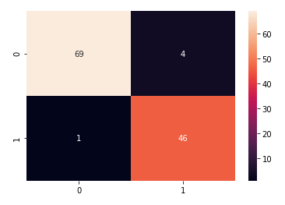
CONFUSION MATRIX OF LINEAR CLASSIFIER
True Negative | TN | 00 | 69
True Positive | TP | 11 | 46
False Negative | FN | 10 | 04
False Positive | FP | 01 | 01
Calculation:
TP+TN 46+69 115
TP+TN+FN+FP 46+69+04+01 120
0.95833

Slide 23
CLASSIFICATION REPORT OF LINEAR CLASSIFIER
Precision: Tell us how many of the correctly predicted cases actually turned out to be positive
Recall: Tell us how many of the actual positive cases we were able to predict correctly with our model
F1-score: harmonic mean of precision & Recall, So it gives a combined odea about these 2 metric. It is maximum when precision is equal to Recall
 | Precision | Recall | F1-score | Support
0 | 0.99 | 0.95 | 0.97 | 73
1 | 0.92 | 0.98 | 0.95 | 47
Accuracy |  |  | 0.96 | 120
Macro average | 0.95 | 0.96 | 0.96 | 120
Weighted average | 0.96 | 0.96 | 0.96 | 120
TP
TP+FP
TP
TP+FN

Slide 24
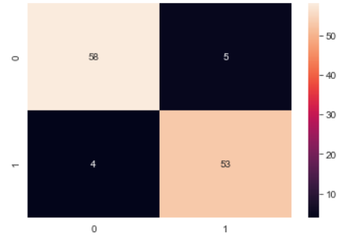
CONFUSION MATRIX OF KNN
True Negative | TN | 00 | 58
True Positive | TP | 11 | 53
False Negative | FN | 10 | 05
False Positive | FP | 01 | 04
Calculation:
TP+TN 53+58 111
TP+TN+FN+FP 53+58+05+04 120
0.925

Slide 25
CLASSIFICATION REPORT OF KNN
Precision: Tell us how many of the correctly predicted cases actually turned out to be positive
Recall: Tell us how many of the actual positive cases we were able to predict correctly with our model
F1-score: harmonic mean of precision & Recall, So it gives a combined odea about these 2 metric. It is maximum when precision is equal to Recall
 | Precision | Recall | F1-score | Support
0 | 0.94 | 0.92 | 0.93 | 63
1 | 0.91 | 0.93 | 0.92 | 57
Accuracy |  |  | 0.93 | 120
Macro average | 0.92 | 0.93 | 0.92 | 120
Weighted average | 0.93 | 0.93 | 0.93 | 120
TP
TP+FP
TP
TP+FN

Slide 26
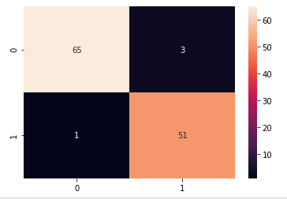
CONFUSION MATRIX OF SVM
True Negative | TN | 00 | 65
True Positive | TP | 11 | 51
False Negative | FN | 10 | 03
False Positive | FP | 01 | 01
Calculation:
TP+TN 51+65 116
TP+TN+FN+FP 51+65+03+01 120
0.96666

Slide 27
CLASSIFICATION REPORT OF SVM
Precision: Tell us how many of the correctly predicted cases actually turned out to be positive
Recall: Tell us how many of the actual positive cases we were able to predict correctly with our model
F1-score: harmonic mean of precision & Recall, So it gives a combined odea about these 2 metric. It is maximum when precision is equal to Recall
 | Precision | Recall | F1-score | Support
0 | 0.98 | 0.96 | 0.97 | 68
1 | 0.94 | 0.98 | 0.96 | 52
Accuracy |  |  | 0.97 | 120
Macro average | 0.96 | 0.97 | 0.97 | 120
Weighted average | 0.97 | 0.97 | 0.97 | 120
TP
TP+FP
TP
TP+FN

Slide 28
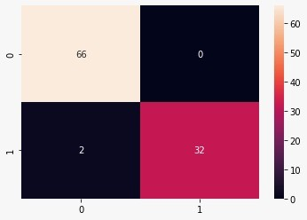
CONFUSION MATRIX OF Random Forest
True Negative | TN | 00 | 66
True Positive | TP | 11 | 32
False Negative | FN | 10 | 00
False Positive | FP | 01 | 02
Calculation:
TP+TN 32+66 98
TP+TN+FN+FP 32+66+00+02 100
0.98

Slide 29
CLASSIFICATION REPORT OF Random Forest
Precision: Tell us how many of the correctly predicted cases actually turned out to be positive
Recall: Tell us how many of the actual positive cases we were able to predict correctly with our model
F1-score: harmonic mean of precision & Recall, So it gives a combined odea about these 2 metric. It is maximum when precision is equal to Recall
 | Precision | Recall | F1-score | Support
0 | 0.94 | 1.00 | 0.97 | 66
1 | 1.00 | 0.88 | 0.94 | 34
Accuracy |  |  | 0.96 | 100
Macro average | 0.97 | 0.94 | 0.95 | 100
Weighted average | 0.96 | 0.96 | 0.96 | 100
TP
TP+FP
TP
TP+FN

Slide 30
CONFUSION MATRIX OF XGBoost
True Negative | TN | 00 | 66
True Positive | TP | 11 | 32
False Negative | FN | 10 | 00
False Positive | FP | 01 | 02
Calculation:
TP+TN 32+66 98
TP+TN+FN+FP 32+66+00+02 100
0.98

Slide 31
CLASSIFICATION REPORT OF XGBoost
Precision: Tell us how many of the correctly predicted cases actually turned out to be positive
Recall: Tell us how many of the actual positive cases we were able to predict correctly with our model
F1-score: harmonic mean of precision & Recall, So it gives a combined odea about these 2 metric. It is maximum when precision is equal to Recall
 | Precision | Recall | F1-score | Support
0 | 0.97 | 1.00 | 0.99 | 66
1 | 1.00 | 0.94 | 0.97 | 34
Accuracy |  |  | 0.98 | 100
Macro average | 0.99 | 0.97 | 0.98 | 100
Weighted average | 0.98 | 0.98 | 0.98 | 100
TP
TP+FP
TP
TP+FN

Slide 32
CONFUSION MATRIX OF Navie Bayes
True Negative | TN | 00 | 62
True Positive | TP | 11 | 34
False Negative | FN | 10 | 04
False Positive | FP | 01 | 00
Calculation:
TP+TN 34+62 96
TP+TN+FN+FP 34+62+04+00 100
0.96

Slide 33
CLASSIFICATION REPORT OF Navie Bayes
Precision: Tell us how many of the correctly predicted cases actually turned out to be positive
Recall: Tell us how many of the actual positive cases we were able to predict correctly with our model
F1-score: harmonic mean of precision & Recall, So it gives a combined odea about these 2 metric. It is maximum when precision is equal to Recall
 | Precision | Recall | F1-score | Support
0 | 1.00 | 0.94 | 0.97 | 66
1 | 0.89 | 1.00 | 0.94 | 34
Accuracy |  |  | 0.96 | 100
Macro average | 0.95 | 0.97 | 0.96 | 100
Weighted average | 0.96 | 0.96 | 0.96 | 100
TP
TP+FP
TP
TP+FN

Slide 34
MODULE 5: EVALUTAION
The Linear Classifier, Support Vector Machine (SVM), K-Nearest Neighbors (KNN), XGBoost, Naive Bayes, and Random Forest machine learning techniques were utilised. Several measures were used to assess how well these classifiers performed. The XGBoost fared better with 98 percent accuracy. However, as the dataset was a little unbalanced, accuracy cannot be the only factor taken into account when evaluating the parameter. Based on Precision, XGBoost and Random Forest both displayed 100%, whereas Linear Classifier also displayed 100%. Based on recall, XGBoost demonstrated 94%, Random Forest demonstrated 94%, and Naive Bayes demonstrated 100%. Based on the F1 score, XGBoost and Random Forest both displayed 96 percent.
 | Accuracy (%) | precision (%) | recall (%) | F1-score (%)
Linear Classifier | 96.0 | 100 | 88.2 | 93.7
KNN | 96.0 | 96.8 | 91.1 | 93.9
SVM | 95.0 | 93.9 | 91.1 | 92.5
XGBoost | 98.0 | 100 | 94.11 | 96.9
Random Forest | 98.0 | 100 | 94.11 | 96.9
Naive Bayes | 96.0 | 89.4 | 100.0 | 94.4

Slide 35
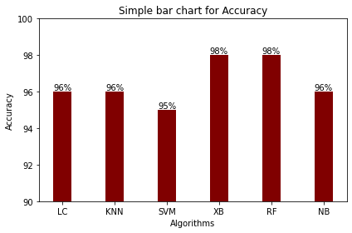
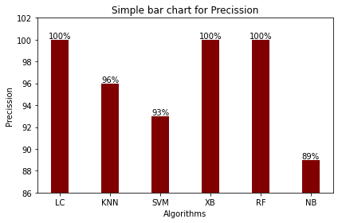
MODULE 5: EVALUTAION

Slide 36
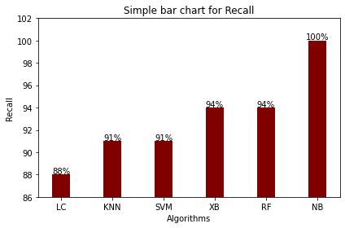
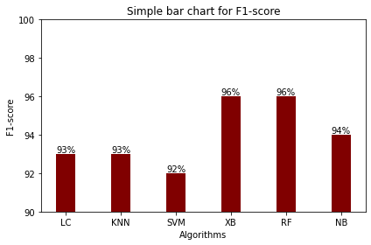
MODULE 5: EVALUTAION

Slide 37
REQUIREMENTS
Hardware Requirements:
Processor : Intel(R) Core(TM) i3-8145U CPU @ 2.10GHz 2.30 GHz
RAM : 256 MB(min)
Storage : 20 GB
Standard Devices : Keyboard, Monitor and Mouse
Software Requirements:
    OS : Windows
    Language : Python
    IDE/tool : Jupyter Notebook
    Dataset : https://www.kaggle.com/datasets/mansoordaku/ckdisease

Slide 38
CONCLUSION
One of the disorders that affects a lot of individuals is chronic kidney disease (CKD). The disease is frequently only discovered once it has progressed to an advanced state because the symptoms of CKD are not noticeable in the early stages. This could result in kidney failure and death. Machine learning classifiers offer an effective means of early disease prediction. Based on Precision, XGBoost and Random Forest both displayed 100%, whereas Linear Classifier also displayed 100%. Based on recall, XGBoost demonstrated 94%, Random Forest demonstrated 94%, and Naive Bayes demonstrated 100%. Based on the F1 score, XGBoost and Random Forest both displayed 96 percent. After examining every metric, we can say that accuracy is a good indicator if the datasets are fairly balanced and all types of outputs are valued equally. However, F1-score combines precision and recall and can be used in cases where the datasets are unbalanced because it requires both precision and recall to have a reasonable value. Based on F1-score XGBoost and Random Forest showed 96%. By carefully analyzing about the bagging and boosting algorithms, boosting algorithms can be more precise than the bagging algorithms. Based on the evaluation XG Boost concluded as the best classifier when compared with all the other algorithms.

Slide 39
FUTURE WORK
It is important to investigate how the KNN imputer-based method may be used in the future to handle missing values in data sets relating to various diseases.
It is important to investigate how the Embedded method of feature selection may be used for selecting and tunung the subset of features during the model creation process.

Slide 40
REFERENCES
[1] Akanksha Soni and Dr. Avinash Rai “Kidney stone recognition and extraction usingDirectional Emboss &amp; SVM from Computes Tomography Images” in 2020 Third International Conference on Multimedia Processing, Communication &amp; Information Technology – MPCIT 2020 JNNCE, Shivamogga, Karnataka, India DOI:10.1109/MPCIT51588.2020.9350388
[2] M.Akshaya, R.Nithushaa, N.Sri Madhava Raja and S.Padmapriya “Kidney Stone Detection Using Neural Networks” in 2020 International conference on system, computation, automation and networking (ICSCAN). DOI: 10.1109/ICSCAN49426.2020.9262335
[3] Gabriel R. Vasquez- Morales, Sergio M. Martinez-Monterrubio, Pablo Moreno- Ger, and Juan A. Recio-Garcia, ‘‘Explainable Prediction of Chronic Renal Disease in the Colombian Population Using Neural Networks and Case-Based Reasoning,’’ in 2019 IEEE Access DOI: 10.1109/ACCESS.2019.2945430
[4] L. Antony et al., “A Comprehensive Unsupervised Framework for Chronic Kidney Disease Prediction,” in IEEE Access, vol. 9, pp. 126481-126501, 2021, doi: 10.1109/ACCESS.2021.3109168.
[5] Pankaj chittora, Sandeepchaurasia ,Prasunchakrabatri, Guaravkumawat “Chronic Kidney disease prediction using Machine Learning,” in 2021 IEEE Access 2021 DOI: 10.1109/ACCESS.2021.3053763

Slide 41
Thank You

